Slide 1

RESUME CLASSIFICATION PROJECT
Group4

Slide 2

TEAM MEMBERS

Slide 3

LOGO
ENTER TITLE
OBJECTIVE
The document classification solution should significantly reduce the manual human effort in the HRM. It should achieve a higher level of accuracy and automation with minimal human intervention

Slide 4
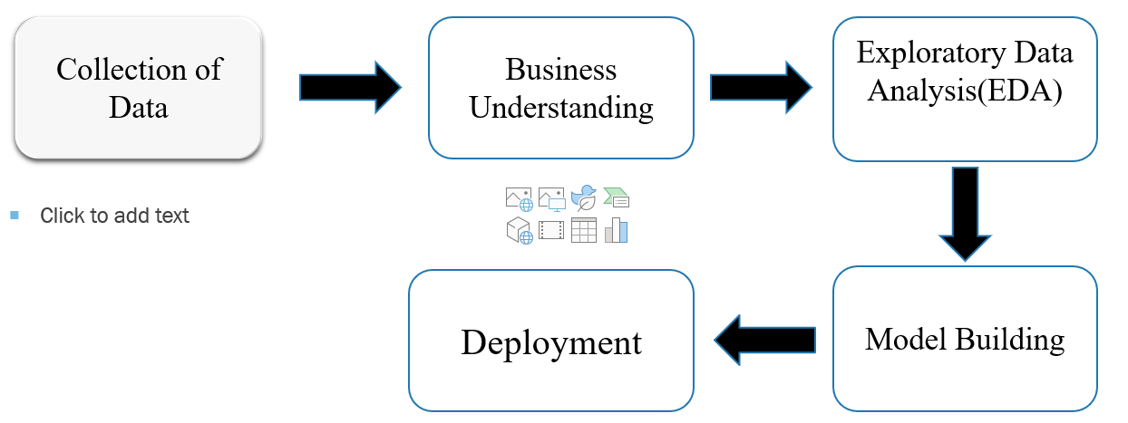
PROJECT ARCHITECTURE

